Slide 1
D3L
The Superior Version of D2L

Slide 2
Components
Login Page
Registration Page
Homepage
Administrator Homepage
Profile Page
Course Page

Slide 3
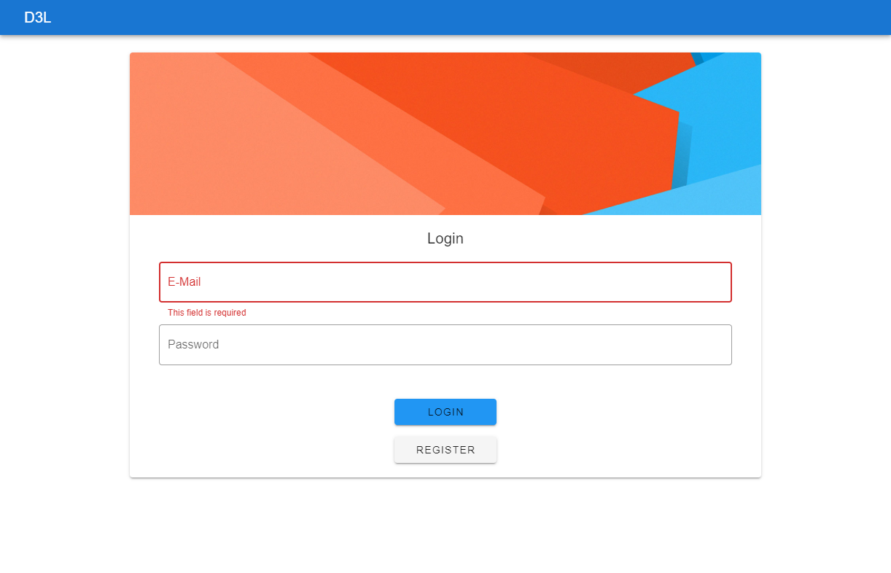
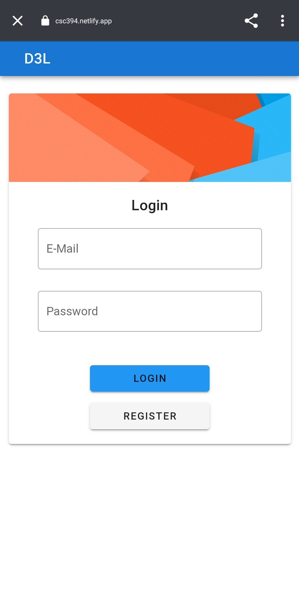
Login Page
Application’s landing page
Fields (all required)
Email
Password
Buttons
Login button
Enter key or click
Register button
Leads to registration page

Slide 4
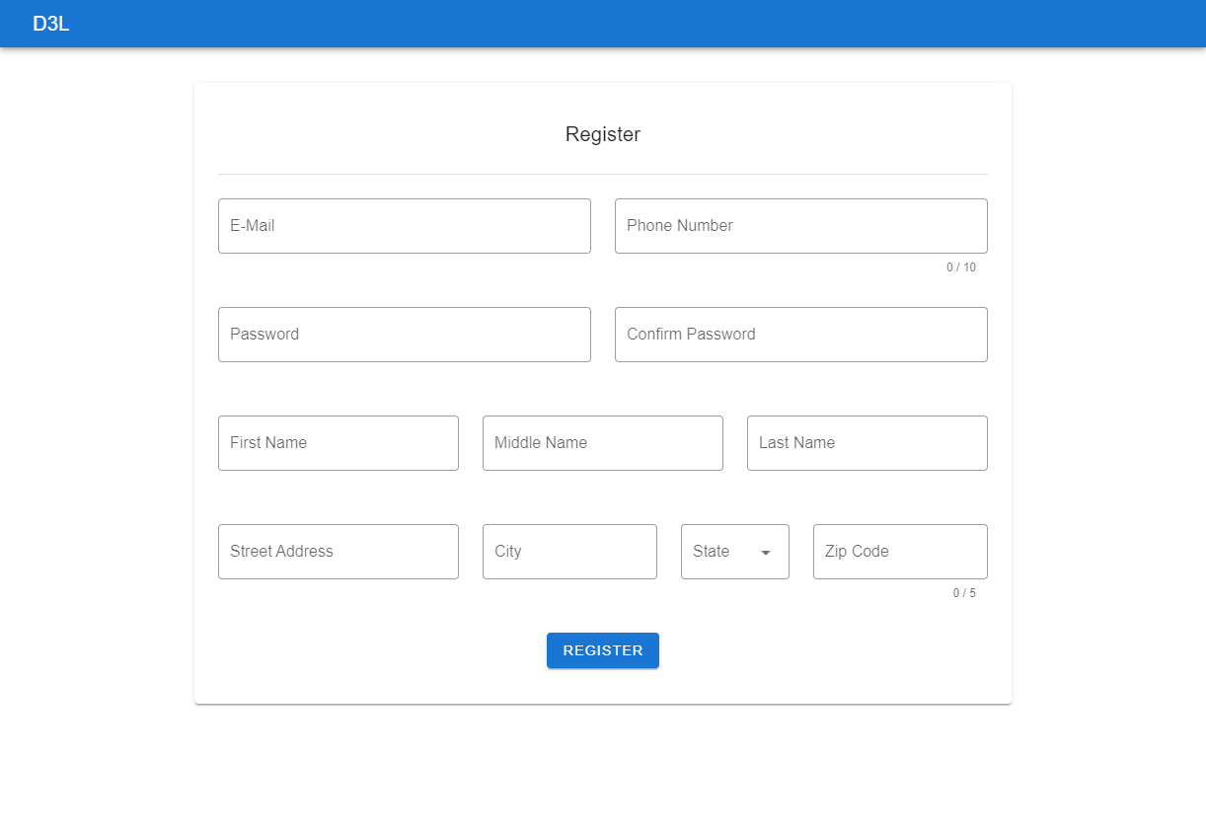
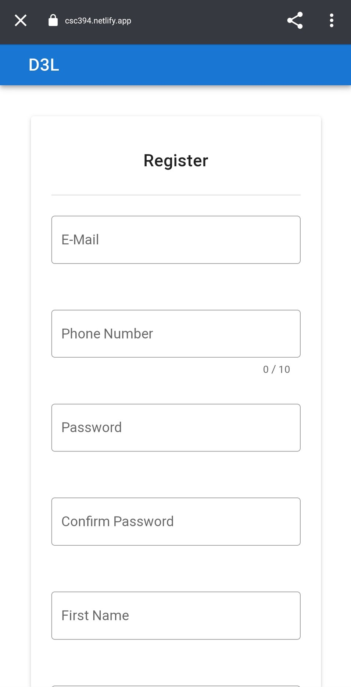
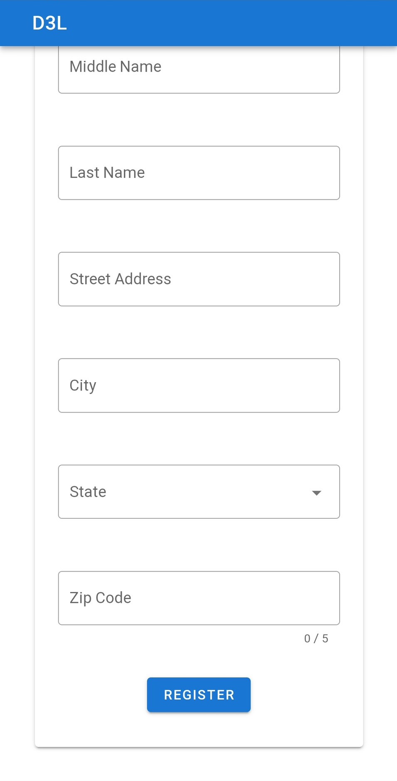
Registration Page
Fields request relevant information
All required
Character limits on some
Zip code, phone number, etc.

Slide 5
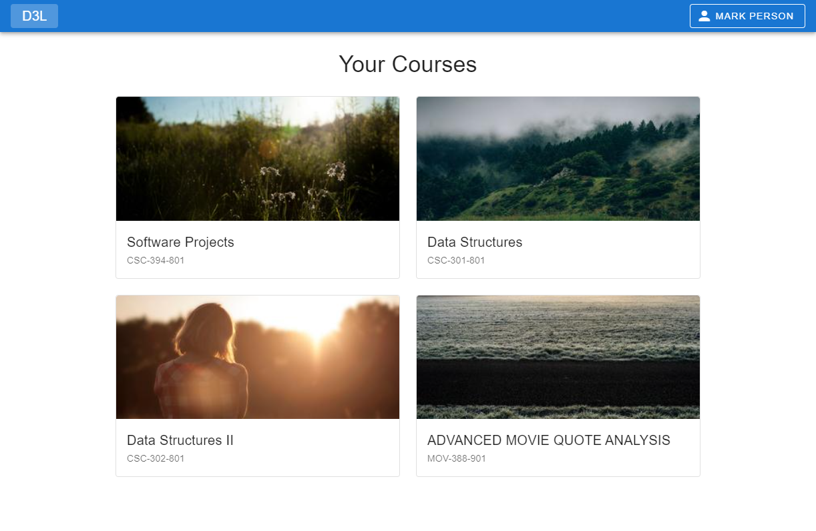
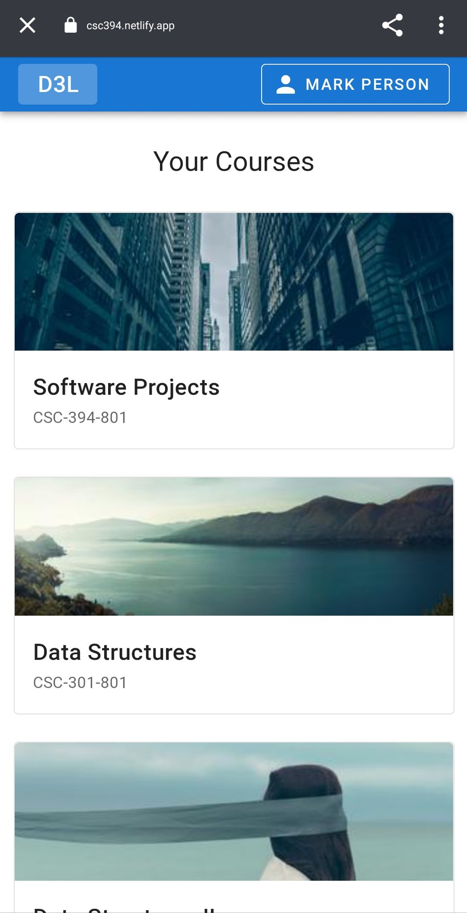
Homepage
Navigation bar
Present on all non-login pages
D3L button — Return to homepage
Drop-down menu
Via right-hand button (w/ user’s full name)
Options
Visit profile page
Log out

Slide 6

Homepage (Administrator)
Admin toolbar
Buttons
Add New Course
Create new course in DB
Pop-up window — Course title, prefix, number, section
Add Course
Pop-up window — Add specific users to one or more courses
Add Role
Pop-up window — Assign roles to a selected user
Other parts of admin homepage identical to faculty/student homepage

Slide 7
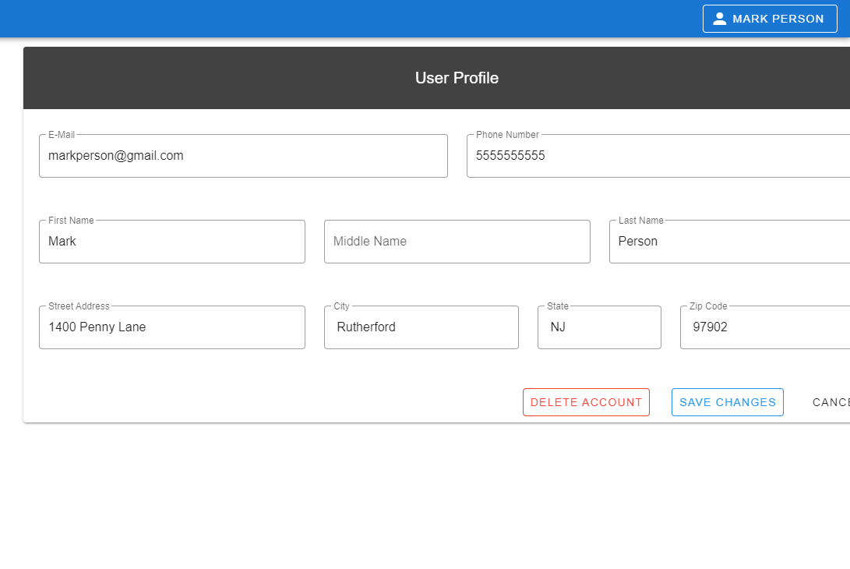
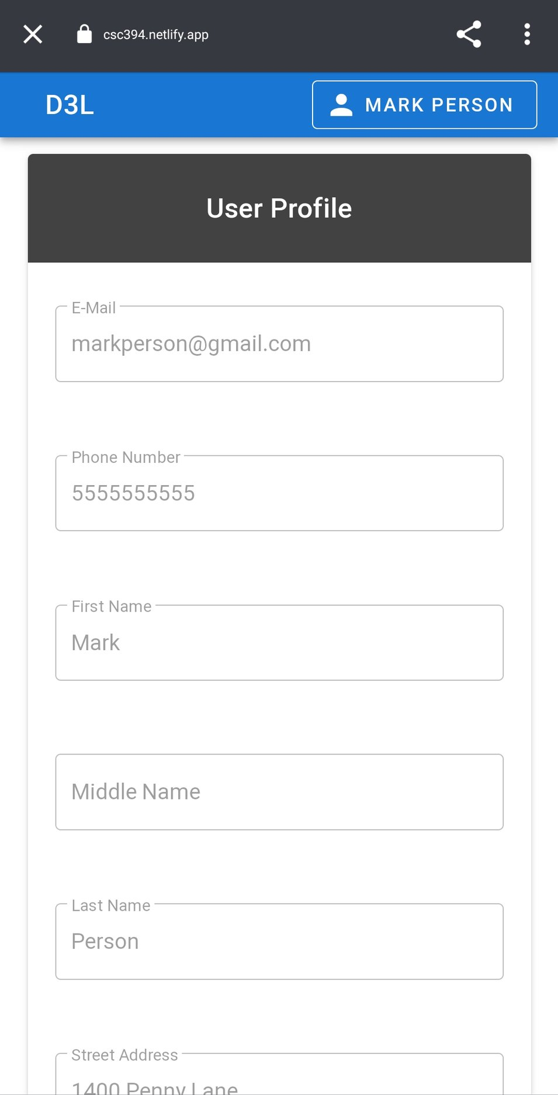
Profile Page
Displays info from user registration
Buttons
Edit
Enables field modification
Cancel
Exit editing mode
Return to viewing mode
Buttons (cont’d)
Delete Account
Prompt user for confirmation
Delete account and log out
Save Changes
Register changed fields in DB

Slide 8
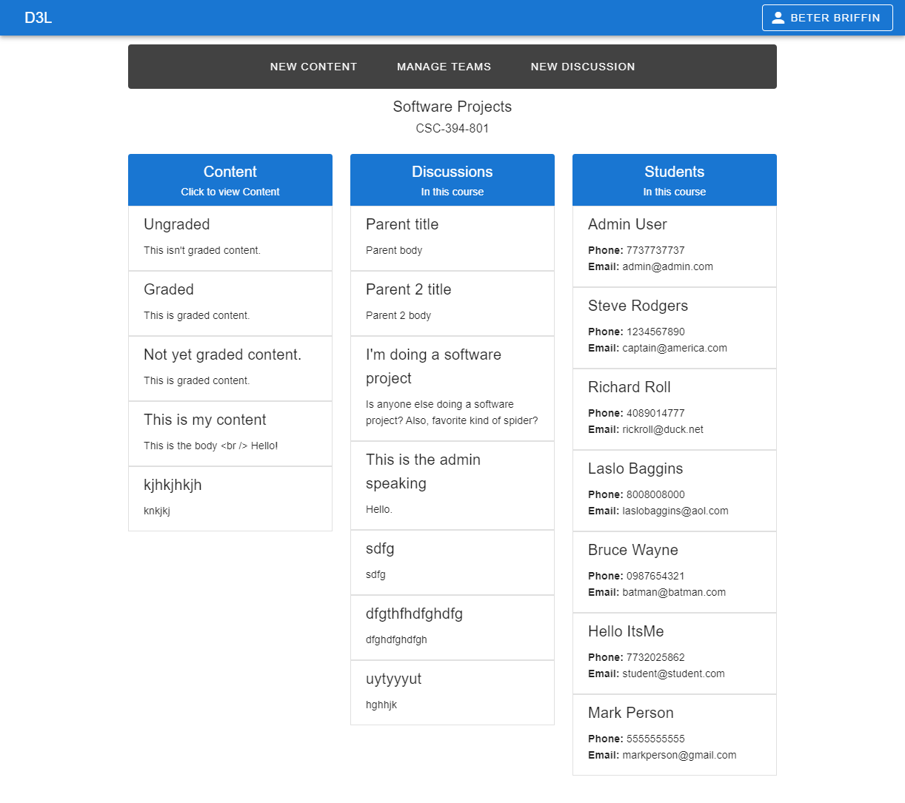
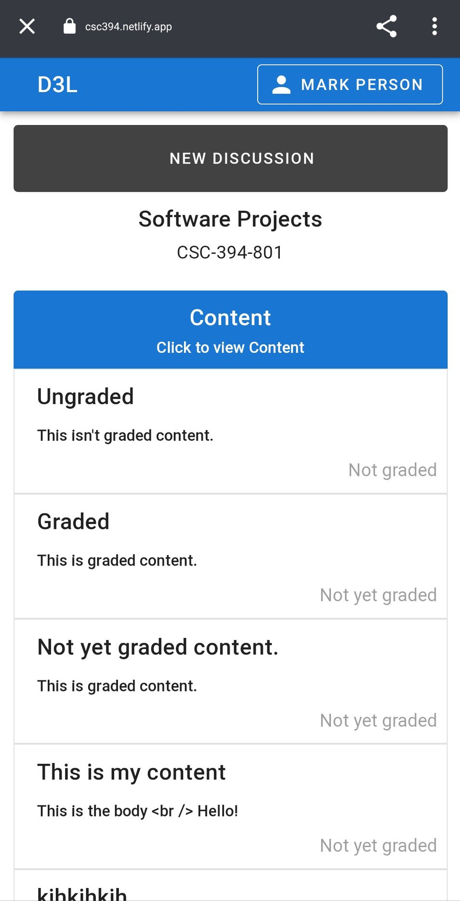
Course Page
Content section
Graded and ungraded
Download to device (if applicable)
Display on click:
Description
Point total (if applicable)
Discussion section
List of parent posts
Display on click:
List of responses to parent post
Student section
List of students in course

Slide 9
Enjoy D3L!
Application:
https://csc394.netlify.app
Source code:
https://github.com/wesamjabali/d3l-ui
https://github.com/wesamjabali/d3l-backend

